Slide 1

假设 H: M →T 是一个哈希函数 ( |M| >> |T| )
则 H 发生碰撞表示存在 m₀ , m₁ ∈ M 导致:
H(m₀) = H(m₁) and m₀ ≠ m₁
目标：构建抗碰撞的哈希函数

Slide 2


Slide 3
m[0]
m[1]
m[2]
m[3] ll PB
IV
(fixed)
h
h
h
h
H(m)
H₀
H₁
H₂
H₃
H₄
给出函数 h: T × X ⟶ T (compression function)
得到 H: X^{≤L} ⟶ T H_{i} - chaining variables
PB: padding block
1000…0 ll msg len
若没有足够的空间添加PB
应添加冗余分组
64 bits

Slide 4

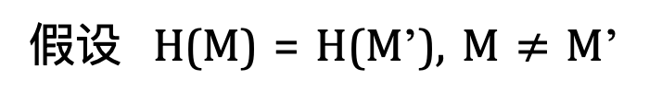
定理：若h是CR的，则H也是
假设 H(M) = H(M’), M $≠$ M’
证明：
IV = H₀ , H₁ , … , H_{t} , H_{t+1} = H(M)
IV = H₀’ , H₁’ , … , H’_{r}, H’_{r+1} = H(M’)

Slide 5
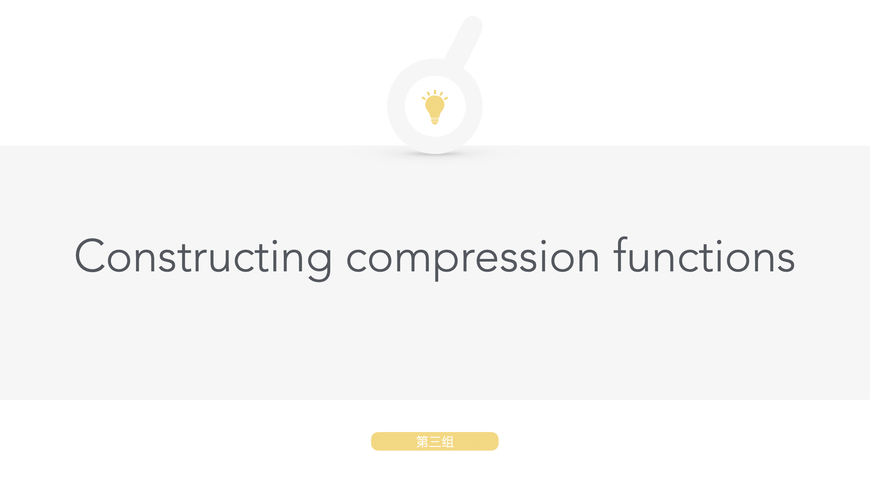

Slide 6
通过分组密码构建compr. func.
E: K× {0,1}^{n} ⟶ {0,1}^{n} 是一个分组密码
Davies-Meyer 压缩函数: h(H, m) = E(m, H)⨁H
Thm: 假设 E 是一个理想的密码( |K| 个随机排列的集合).
找到一个碰撞h(H,m)=h(H’,m’) 要评估 O(2^{n/2}) 次 (E,D).
m_{i}
E
⨁
H_{i}

Slide 7

假设 h(H, m) = E(m, H)
则 h(.,.) 不是抗碰撞的:
为了寻找碰撞 (H,m) 和 (H’,m’) 我们可以选择随机的 (H,m,m’) 并构建 H’ :
H’=D(m’, E(m,H))
H’=E(m’, D(m,H))
H’=E(m’, E(m,H))
H’=D(m’, D(m,H))

Slide 8
Other block cipher constructions
假设 E: {0,1}^{n} × {0,1}^{n} ⟶ {0,1}^{n}
Miyaguchi-Preneel:
h(H, m) = E(m, H)⨁H⨁m (Whirlpool)
h(H, m) = E(H⨁m, m)⨁m
共 12 个似这样的变式
其他的变式是不能抗碰撞的，如:
h(H, m) = E(m, H)⨁m (HW)

Slide 9
案例学习: SHA-256
Merkle-Damgard function
Davies-Meyer compression function
Block cipher: SHACAL-2
512-bit key
SHACAL-2
256-bit block
256-bit block

Slide 10
Provable compression functions
选择一个随机的 2000-bit 素数 p 和随机的 1 ≤ u, v ≤ p
对 m,h ∈ {0,…,p-1} 定义 h(H,m) = u^{H} ⋅ v^{m} (mod p)
Fact: finding collision for h(.,.) is as hard as solving “discrete-log” modulo p.
Problem: slow.

Slide 11


Slide 12


Slide 13
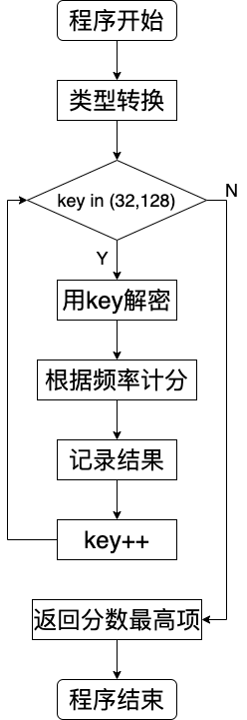
The hex encoded string:
1b37373331363f78151b7f2b783431333d
78397828372d363c78373e783a393b3736
Has been XOR'd against a single character.
Find the key, decrypt the message.

Slide 14
#遍历备选密钥
def Traversal_singlechar(hex_string):
candidate=[]
for candidate_key in range(32, 128):
plaintext=single_xor(candidate_key,hex_string)
score=get_score(plaintext)
result={
'score':score,
'plaintext':plaintext,
'key':candidate_key
}
candidate.append(result)
return sorted(candidate,key=lambda c:c['score'])[-1]

Slide 15
#获得概率分数
def get_score(string):
score = 0
for char in string:
char = char.lower()
if char in CHARACTER_FREQ:
score += CHARACTER_FREQ[char]
return score
#将hex的每个字符与备选密钥进行xor
def single_xor(candidate_key,hex_string):
result = ""
for i in hex_string:
b = chr(candidate_key ^ i)
result += b
return result

